Slide 1

Investigating the Relationship Between Solar Irradiance and Output Voltage in Photovoltaic Systems: Correlation and Regression Analysis
Presented to:
Dr. Mohiuddin Ahmad Professor
Dept. of Electrical and Electronic Engineering Khulna University of Engineering & Technology (KUET)
Dr. Md. Shahjahan Professor
Dept. of Electrical and Electronic Engineering Khulna University of Engineering & Technology (KUET)
Presented By
Tawseef Salim Rafi Roll:2003022 Dept of Electrical and Electronic Engineering Section: A1 Semester: 3rd Term:1st
Mahdi Muntakim
Roll:2003022 Dept of Electrical and Electronic Engineering Section: A1 Semester: 3rd Term:1st
Course: Sessional on Numerical Methods and Stastistics
Course Code: EE 3122

Slide 2
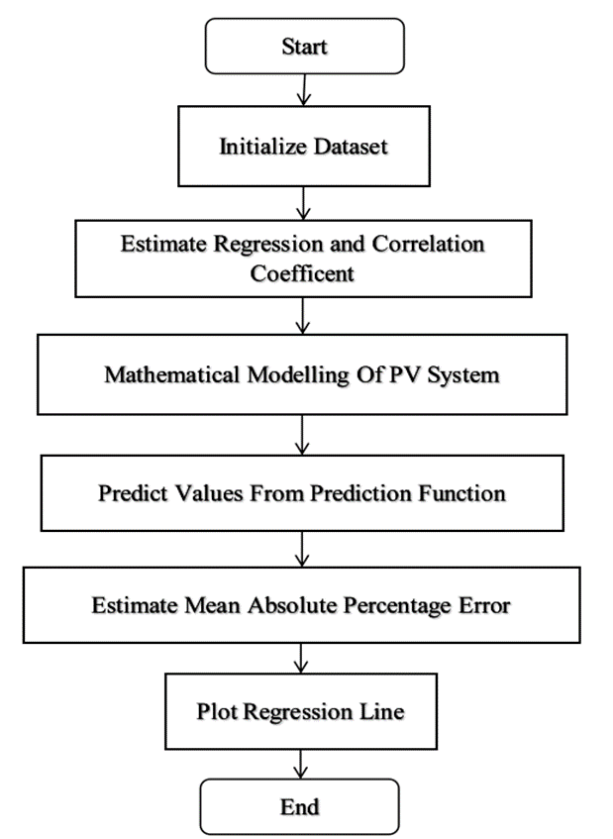
Methodology
Numerical Approach
Correlation Analysis
Regression Analysis
Existence of Relationship between independent variable and dependent variable
Strength of relationship
Causal relationship
Prediction and forecasting
Flowchart

Slide 3
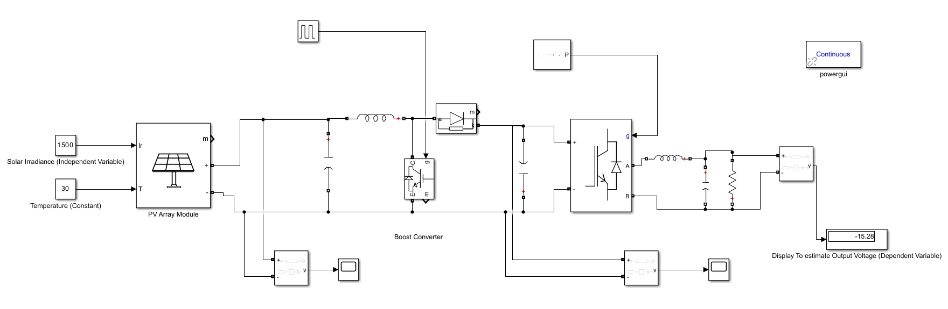
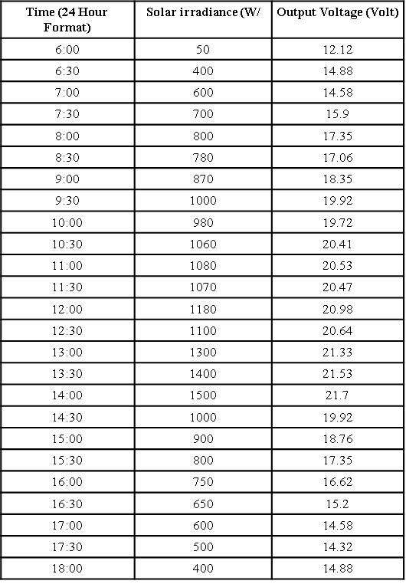
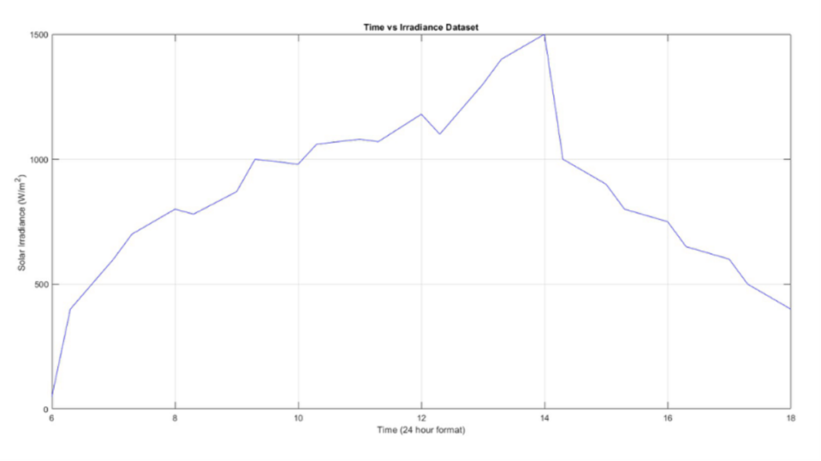
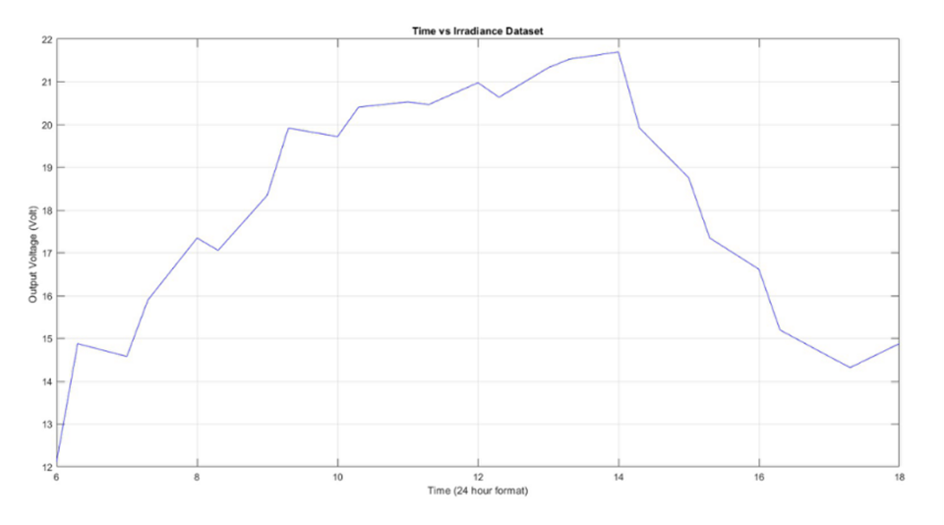
Initialization of dataset
Solar Irradiance
(independent variable)
Output Voltage
(dependent variable)
Solar irradiance vs Time
Output Voltage vs Time

Slide 4
ESTIMATION OF CORRELATION AND REGRESSION COEFFICIENT
CORRELATION COEFFICIENT
REGRESSION COEFFICIENT

Slide 5
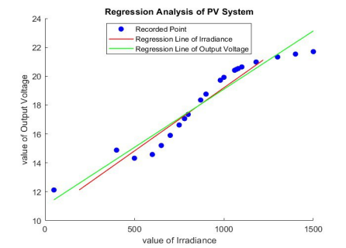
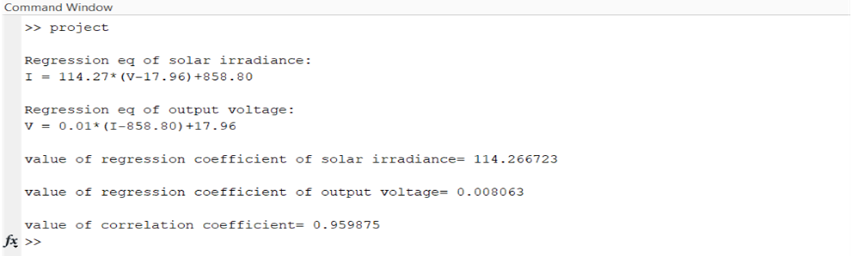
RESULT AND DISCUSSION
Since the value of correlation coefficient is non zero, therefore there is a correlation between solar irradiance and output voltage, which is simple in nature
The value of r is between .9 to .99, so there is a very high positive correlation between them that moves in the same direction
Therefore, when the irradiance is increased, the output voltage also increases and when the irradiance is decreased, the output voltage also decreases

Slide 6
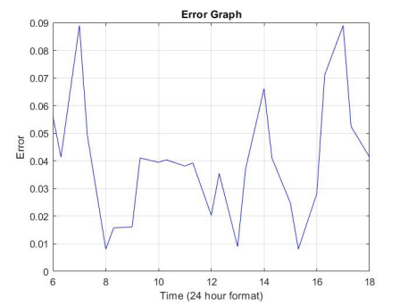
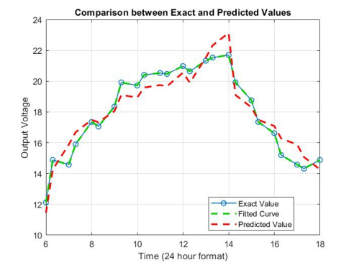
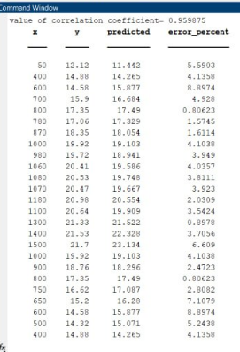

Slide 7
Appendix
%read data from txt file
file=readtable("C:\Users\ASUS\Desktop\Project.txt");
x=file.Var1;
y=file.Var2;
z=file.Var3;
xsquare=x.^2;
ysquare=y.^2;
xy=x.*y;
n=length(x);
xavg=sum(x)/n;
yavg=sum(y)/n;
%regression eq of irradiance on output voltage
Bxy=(n*sum(xy)-sum(x)*sum(y))/(n*sum(ysquare)-(sum(y))^2);
fprintf("\nRegression eq of solar irradiance: \nI = %.2f*(V-%.2f)+%.2f \n",Bxy,yavg,xavg);
%regression eq of output voltage on irradiance
Byx=(n*sum(xy)-sum(x)*sum(y))/(n*sum(xsquare)-(sum(x))^2);
fprintf("\nRegression eq of output voltage: \nV = %.2f*(I-%.2f)+%.2f \n",Byx,xavg,yavg);
%regression and correlation coefficient
fprintf("\nvalue of regression coefficient of solar irradiance= %f \n",Bxy);
fprintf("\nvalue of regression coefficient of output voltage= %f \n",Byx);
r=sqrt(Bxy*Byx);
fprintf("\nvalue of correlation coefficient= %f \n",r);
%Predicting Value from Prediction Function
predicted=zeros(n,1);
for i=1:n
predicted(i)=Byx*(x(i)-xavg)+yavg; %prediction function
end
%Mean Absolute Percentage Error
error=zeros(n,1);
for j=1:n
error(j)=abs((exact(j)-predicted(j))/exact(j));
end
MAPE=sum(error)/n*100
%Error Plot
plot(z, error(1:end),'b-');
xlabel('Time (24 hour format)');
ylabel('Error');
title('Error Graph');
grid on;
%Overall plot
Y=min(y):max(y);
P=Bxy*(Y-yavg)+xavg;
X=min(x):max(x);
Q=Byx*(X-xavg)+yavg;
figure;
scatter(x,y,'b','linewidth',2,'DisplayName','Recorded Point');
hold on;
plot(P,Y,'-r','linewidth',1,'DisplayName','Regression Of Irradiance');
hold on;
plot(X,Q,'-g','linewidth',1,'DisplayName','Regression of Output Voltage');
hold off;
xlabel("value of Irradiance");
ylabel("value of Output Voltage");
title("Regression Analysis of PV System");
legend('Location','best');

Slide 10
AGENDA
Topic one
Topic two
Topic three
Topic four
Topic five

Slide 11

Overcoming nervousness

Slide 12
Engaging the audience
Techniques for connecting
Make eye contact with your audience to create a sense of intimacy and involvement
Weave relatable stories into your presentation using narratives that make your message memorable and impactful
Encourage questions and provide thoughtful responses to enhance audience participation
Use live polls or surveys to gather audience opinions, promoting engagement and making sure the audience feel involved

Slide 13
Selecting Visual Aids

Slide 14
Navigating Q&A Sessions
Preparing for questions
Maintaining composure
Know your material in advance
Anticipate common questions
Rehearse your responses
Maintaining composure during the Q&A session is essential for projecting confidence and authority. Consider the following tips for staying composed:
Stay calm
Actively listen
Pause and reflect
Maintain eye contact

Slide 15

Speaking Impact
Your ability to communicate effectively will leave a lasting impact on your audience
Effectively communicating involves not only delivering a message but also resonating with the experiences, values, and emotions of those listening

Slide 16
Dynamic delivery
METRIC | MEASUREMENT | TARGET | ACTUAL
Audience attendance | # of attendees | 150 | 120
Engagement duration | Minutes | 60 | 75
Q&A interaction | # of questions | 10 | 15
Positive feedback | Percentage (%) | 90 | 95
Rate of information retention | Percentage (%) | 80 | 85
Learn to infuse energy into your delivery to leave a lasting impression
One of the goals of effective communication is to motivate your audience

Slide 17
Speaking engagement metrics
IMPACT FACTOR | MEASUREMENT | TARGET | ACHIEVED
Audience interaction | Percentage (%) | 85 | 88
Knowledge retention | Percentage (%) | 75 | 80
Post-presentation surveys | Average rating | 4.2 | 4.5
Referral rate | Percentage (%) | 10 | 12
Collaboration opportunities | # of opportunities | 8 | 10

Slide 18
THANK YOU
Brita Tamm
502-555-0152
brita@firstupconsultants.com
www.firstupconsultants.com

